Slide 1
µPolar
R - Package Visualization Tools for Time-lapse Microscopic Images

Slide 2
Time-Lapse Images

Slide 3
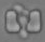
Calculating Distance
Image with cell distance from reference point
Image with
Reference point
(no-cell)
c1
c3
d1
c2
d3
d2
dL4
Image with 4 cells
c4

Slide 4
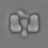
Creating Dataset
time_num
total_objs
trap_num
obj_X
obj_Y
area
dist
cell
Trap Images
1 | 1 | 4 | x1 | y1 | a1 | d1 | c1
1 | 1 | 4 | x2 | y2 | a2 | d2 | c2
1 | 1 | 4 | x3 | y3 | a3 | d3 | c3
1 | 1 | 4 | x4 | y4 | a4 | d4 | c4
1 | 2 | 3 | x1 | y1 | a1 | d1 | c1
1 | 2 | 3 | x2 | y2 | a2 | d2 | c2
1 | 2 | 3 | x3 | y3 | a3 | d3 | c3
Time-point 1
Time-point 2

Slide 5
The correlation for time series observations with observations with previous time steps, called lags
• Autocorrelation function (ACF). At lag k, this is the correlation between series values that are k intervals apart.
• Partial autocorrelation function (PACF). At lag k, this is the correlation between series values that are k intervals apart, accounting for the values of the intervals between.
A plot of the autocorrelation of a time series by lag is called the AutoCorrelation Function, or the acronym ACF.
Data is in time domain

Slide 6
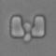
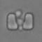
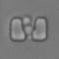
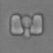
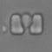
Cells Distance on uPolar (180⁰)
Data is in time domain
1
Covert Cartesian coordinate to Polar coordinate
Degree = 180 / 391 = 0.46
2
4
3
5
3
2
4
1
Degree
5
B
A
0
180

Slide 7
Cells Distance on uPolar (360⁰)
Time-point 01
Time-point 04
Time-point 03
Time-point 05
Time-point 02
Time-point 02
Time-point 01
Time-point 03
0⁰
360⁰
B
Time-point 04
A
Time-point 05

Slide 8
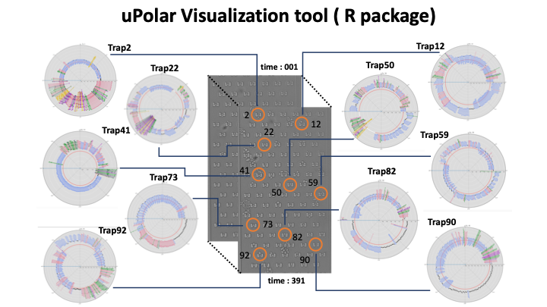

Slide 9
Basic Color Codes for uPolar

Slide 10
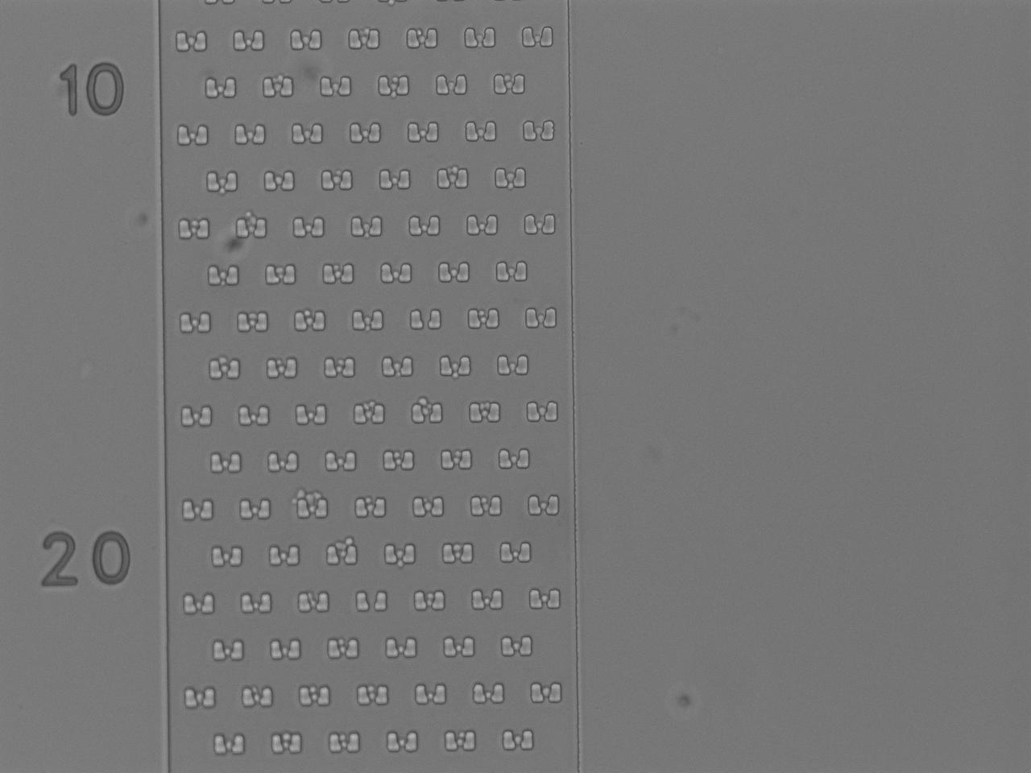
02
01
uPolar Examples
Trap 01
Trap 02
Trap 10
Trap 20
Trap 50
Trap 60
Trap 80
Trap 104
20
10
50
60
80
104

Slide 11
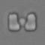
Polar Visualization
BC8 Trap 01
Total Cells
Time-lapsed Images

Slide 12
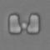
Polar Visualization
BC8 Trap 02
Total Cells
Time-lapsed Images

Slide 13
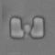
Polar Visualization
BC8 Trap 10
Total Cells
Time-lapsed Images

Slide 14
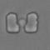
Polar Visualization
BC8 Trap 20
Total Cells
Time-lapsed Images

Slide 15
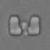
Polar Visualization
BC8 Trap 50
Total Cells
Time-lapsed Images

Slide 16

Polar Visualization
BC8 Trap 60
Total Cells
Time-lapsed Images

Slide 17

Polar Visualization
BC8 Trap 80
Total Cells
Time-lapsed Images

Slide 18
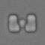
Polar Visualization
BC8 Trap 104
Total Cells
Time-lapsed Images

Slide 19
Thank you
https://github.com/merang/uPolar

